Slide 1
Spinning Sales Tales
Dan Cole
Exhibits Roundtable
September 29, 2022

Slide 2

Turning the Table
Telemarketer---ESR

Slide 3

The SPIN SELLING METHOD

Slide 4
What is SPIN SELING
Renowned book written by Dr. Neil Rackham
Explores 4 “Flavors” of Questions
  Situation
  Problem
  Implication
  Need Payoff
Asked in Sequence
Focus on Problems and Challenges
  Draws out Needs
  Allows for Features and Benefits to be presented in Context

Slide 5

Features and Benefits are Meaningless If:
You Make it about you
You ask the wrong questions
You don’t isolate a pain point
You think that just presenting them earns you the right to ask for the sale

Slide 6

Situation Questions
Situation questions help you understand the buyer’s current situation.
  The goal is to gather information.
Help to unveil status quo
  Goals and Objectives
  Processes
  Why and How
Does not replace background research
Notes:
Situation questions help reps discover the status quo. Use these questions to understand business goals, processes, and other environmental factors. Can you tell me about your role at your company?
As the name suggests, situation questions help you understand the buyer’s current situation. The goal is to gather information. To get you started, we’ve provided some SPIN situation question examples
Walk me through an average day at your job.
What is your approach to [use case]?
Can you tell me about your current processes?
What tools do you currently use?
Why did you invest in these tools?
How effective do you find these tools?
How often do you use them?
Who is responsible for [use case]?
How much budget is assigned to [problem]?
What is your top priority for the year?
Why is this priority important to your business?
Who owns the strategy for [priority]?
Situation questions help reps discover the status quo. Use these questions to understand business goals, processes, and other environmental factors.

Slide 7
Examples of Situation Questions
What is your top priority for the year?
Can you tell me why this is important?
Can you tell me about your current target markets?
Who besides yourself is involved in the buying process?
  Who owns the strategy for your trade show approach
Who are your internal clients?
How much is your trade show budget is assigned to your branding and sales efforts?

Slide 8
JOT IT DOWN
SITUATION QUESTIONS

Slide 9
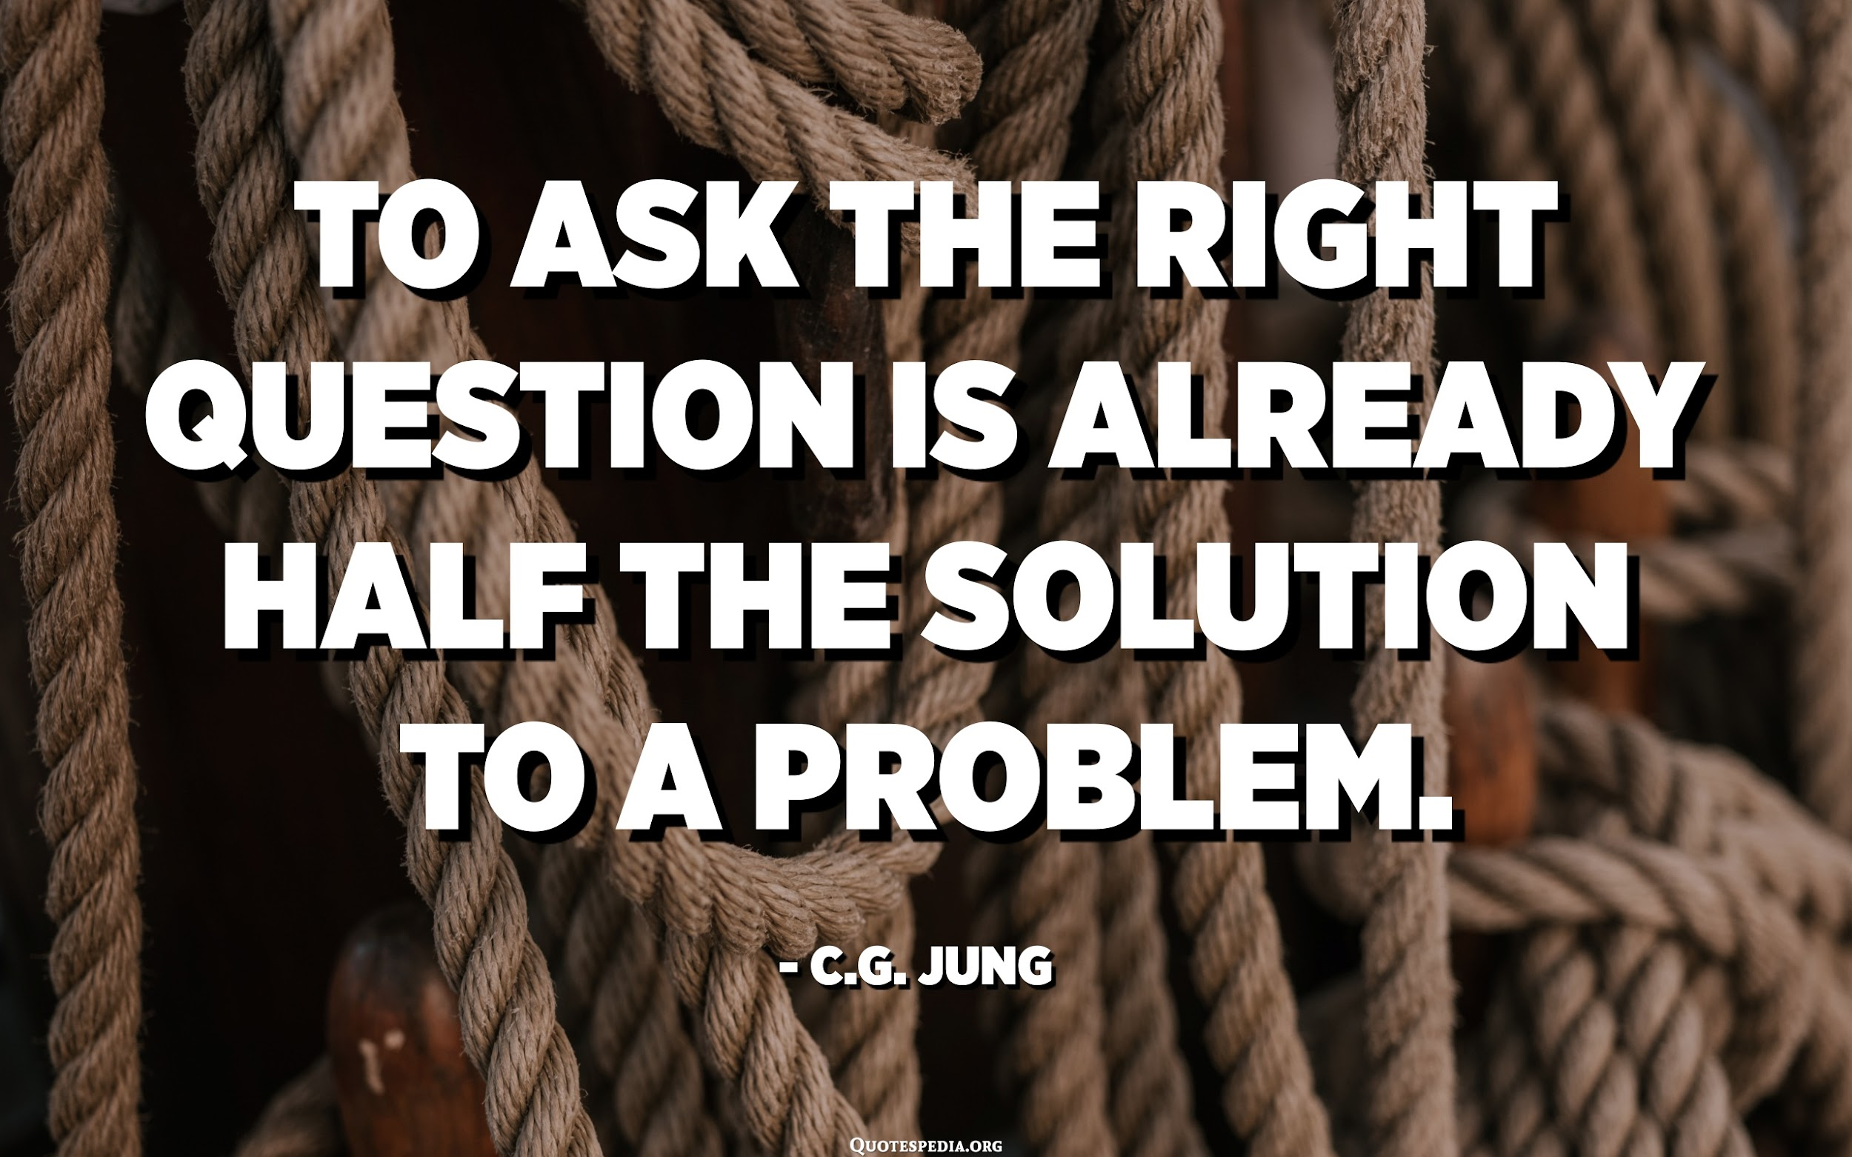
Problem Questions
Help to identify pain points (problems and challenges)
Might Identify problems that buyer did not even know existed
Help to develop implied and explicit needs
Relate directly to a specific feature and benefit of your solution
  Work Backwards
Notes:
Problem questions help reps uncover the buyer’s problem. Use these questions to reveal areas of opportunity, whether stated outright or inferred
How important is [priority] to your business?
What challenges do you anticipate?
What is your biggest day-to-day challenge?
How easy is it to make progress against [priority]?
Why does this approach work/not work for you?
Does your current approach to [priority] ever fail?
What happens if you’re not successful with [priority]?
In a perfect world, what would your approach look like?
Do you think [problem] can be solved?
What’s stopping you from solving it?

Slide 10
Examples of Problem Questions
How easy is it to make progress against number your one priority?
Why does this approach work/not work for you?
Does your current approach ever fail?
What happens if you’re not successful with your number one priority
Do you think [problem] can be solved?
What’s stopping you from solving it?

Slide 11
JOT IT DOWN
PROBLEM QUESTIONS

Slide 12

Implication Questions
Questions help to create a sense of urgency around solving a problem
Helps prospect concentrate on value: Big Problem? Great Solution
Show ramifications of not solving a problem
If asked too much, can create a sense of doom and gloom

Slide 13
Implied vs. explicit
Implied needs are problems and frustrations expressed by the
  “Our system creates too much waste.”
Explicit needs are strong wants or desires expressed by the customer
  We need a more efficient system,” or “We have to cut our procurement costs.”
In a large sale, implied needs are a starting point requiring further development into explicit needs.

Slide 14
Examples of Implication Questions
How do you justify your sales travel expenses to individual clients?
What goal would you like to achieve that you currently can’t because of the lack of efficiency in visiting one client at a time?
How is the lack of brand awareness vs. your competition affect the company?
Could you create a better customer experience by meeting with your clients outside of their offices?

Slide 15
JOT IT DOWN
IMPLICATION QUESTIONS

Slide 16
Need Payoff Questions
A prelude to Features/Benefits
Foreshadows value of addressing challenge with your solution
Need-payoff questions guide buyers to see the benefits of solving the problem
Encourages the buyer to positively endorse the solution to their problem using
your solution
WORK BACKWORDS.
Notes:
Need-payoff questions guide buyers to see the benefits of solving the problem and the payoff for taking action now rather than later. Use these questions to move the buyer towards a specific next step.

Slide 17
Examples of Need Payoff Questions
What would change if you did [approach] differently?
How would it be easier to achieve [priority] with [solution]?
Would your team get value from [solution]?
How do you think solving [problem] would help you?
What would achieving [priority] unlock for your business?

Slide 18
JOT IT DOWN
NEEDS PAYOFF QUESTIONS

Slide 19



Avoid These Mistakes
Too many situation questions
Not researching
Not Seeking first to understand
Trying to Persuasion, not educate and create value
Not connecting Features and Benefits to Need Payoff Questions
Lack of candor
Not creating a next step

